Slide 2
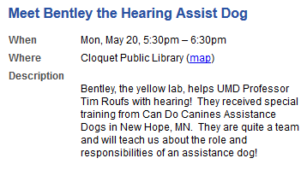

Slide 4
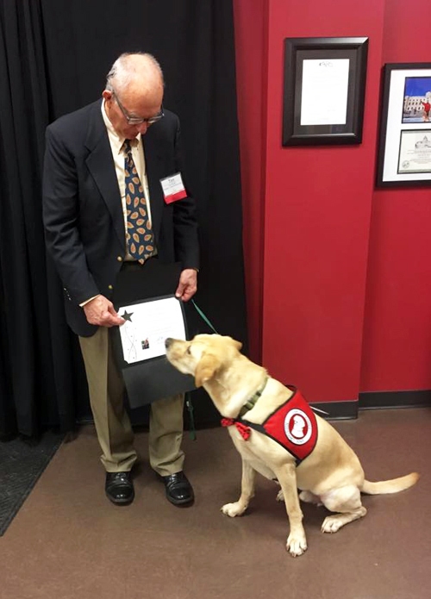

Slide 5
Tim and his Hearing Assistant Partner Bentley are graduates of the Can Do Canine Assistance Dog training program
New Hope, MN

Slide 6
"Total Confidence in Bentley"
Can Do Canines Assistant Dog Feature Story
6 February 2019
link

Slide 7
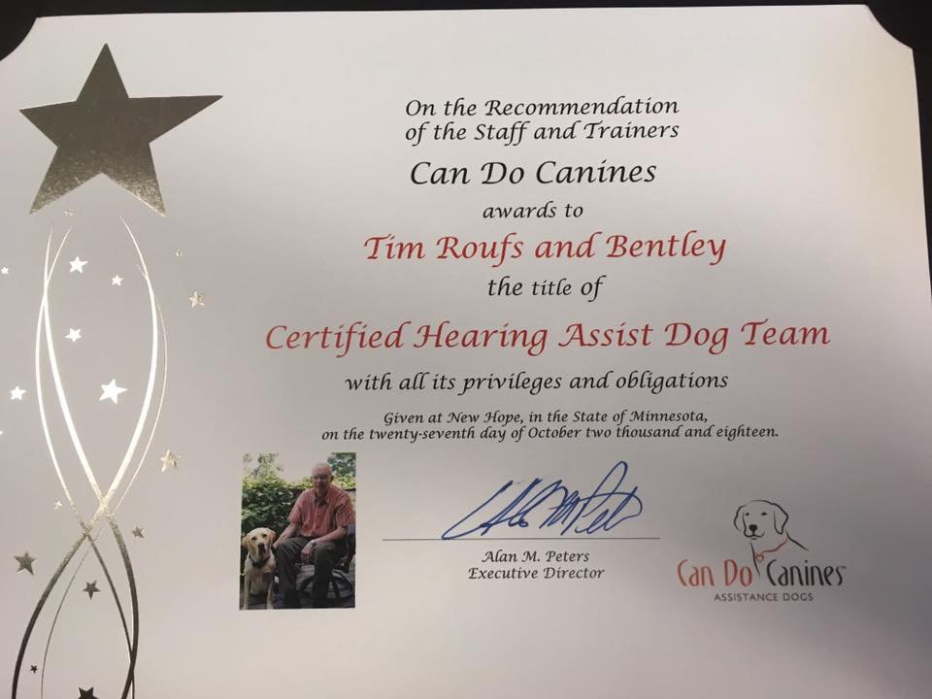

Slide 9
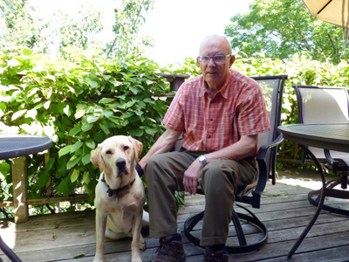
Can Do Canines
is an accredited member of Assistance Dogs International
a nonprofit organization whose purpose is to improve the areas of training, placement and utilization of assistance dogs

Slide 10
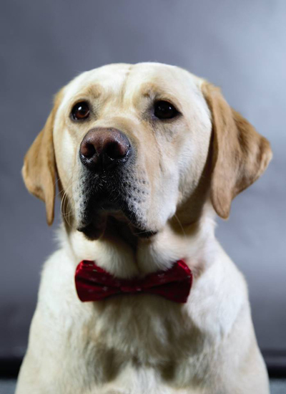
Bentley is also the UMD Tau Kappa Epsilon "Chapter Good Boy"

Slide 11
One of the questions we’re often asked,
about a subject of confusion amongst the general public, is . . .
“What is the difference between a ‘service dog’ and a ‘therapy dog’?”
And we’re also asked what’s the difference between those two and an “emotional support dog”?
?

Slide 12
One of the questions we’re often asked,
about a subject of confusion amongst the general public, is . . .
“What is the difference between a ‘service dog’ and a ‘therapy dog’?”
And we’re also asked what’s the difference between those two and an “emotional support dog”?

Slide 13
One of the questions we’re often asked,
about a subject of confusion amongst the general public, is . . .
“What is the difference between a ‘service dog’ and a ‘therapy dog’?”
And we’re also asked what’s the difference between those two and an “emotional support dog”?

Slide 14
One of the questions we’re often asked,
about a subject of confusion amongst the general public, is . . .
“What is the difference between a ‘service dog’ and a ‘therapy dog’?”
And we’re also asked what’s the difference between those two and an “emotional support dog”?

Slide 15
A handout from Can Do Canines
helps clarify the difference . . .

Slide 16
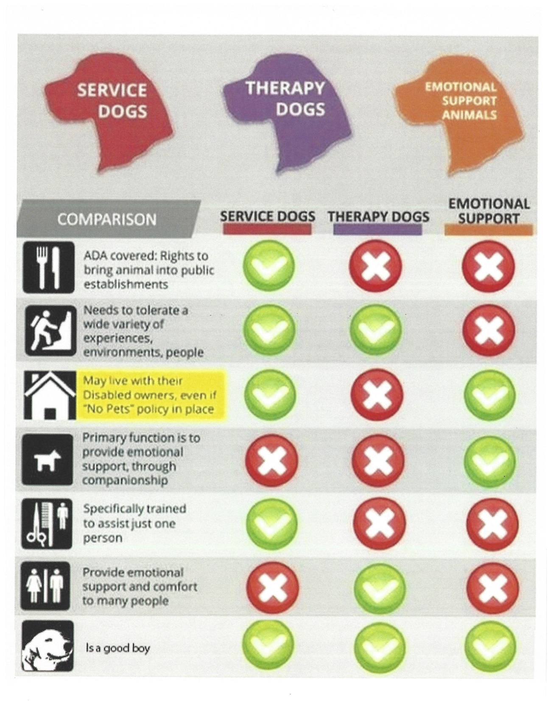

Slide 17
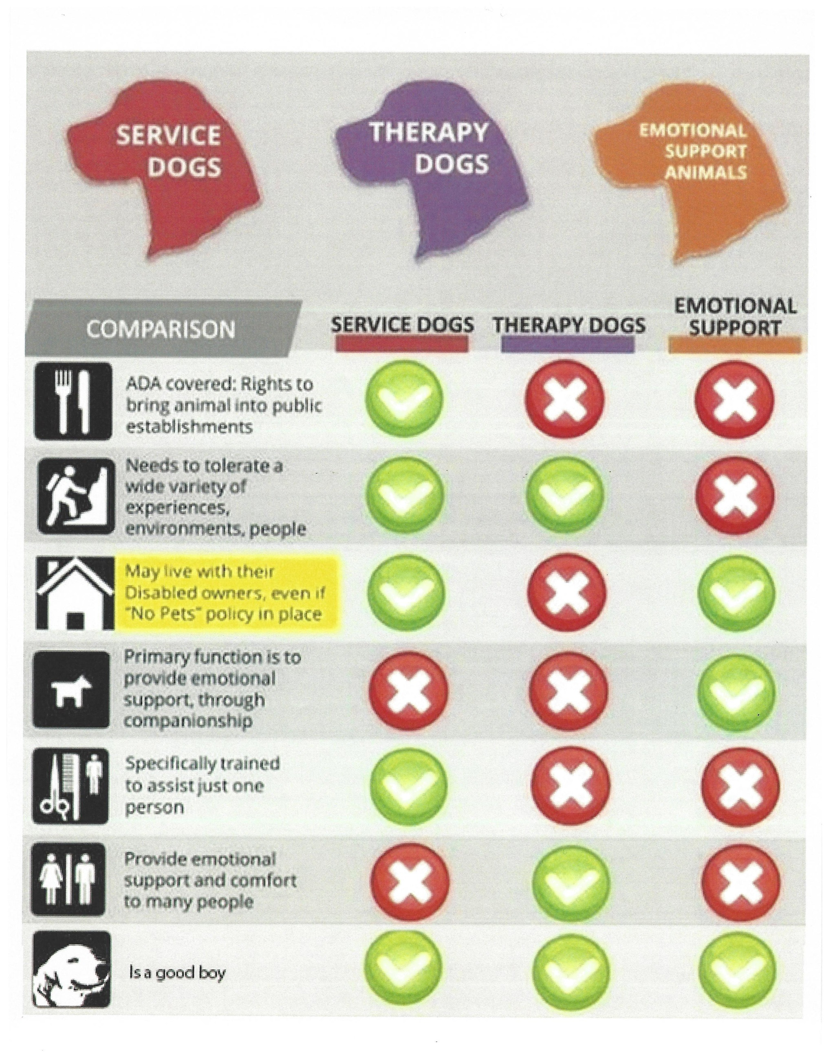

Slide 21
Americans with Disabilities Act

Slide 23
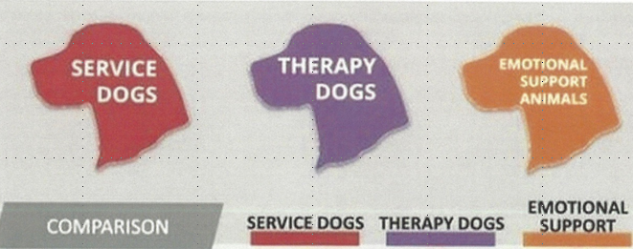

Slide 26
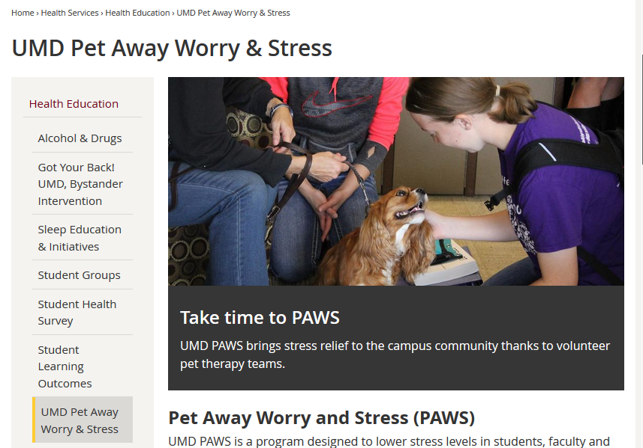

Slide 31
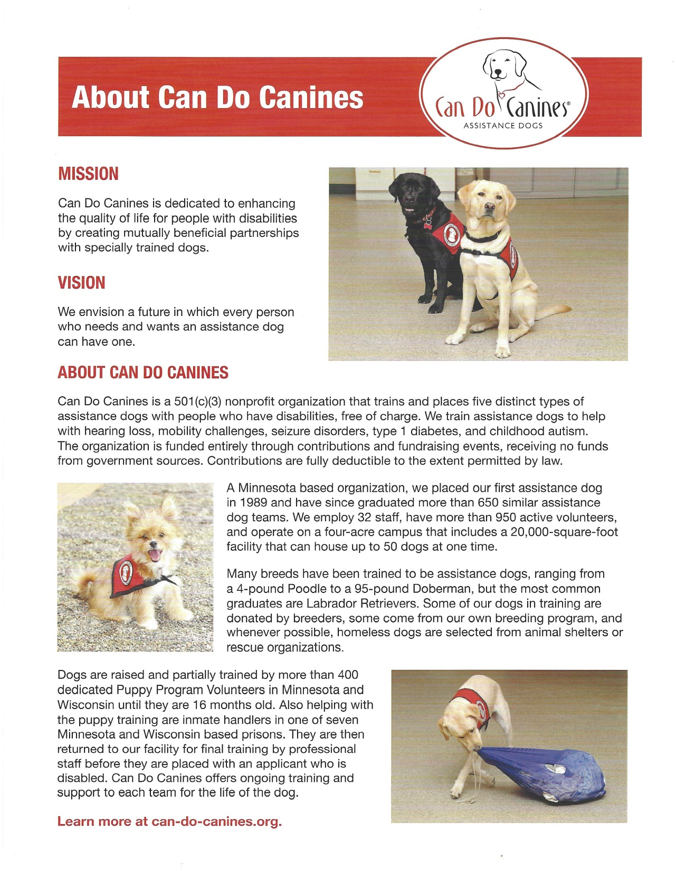

Slide 33
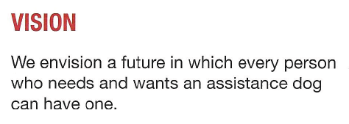

Slide 35
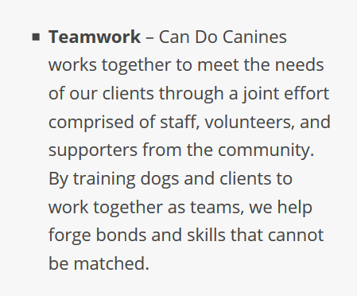

Slide 36
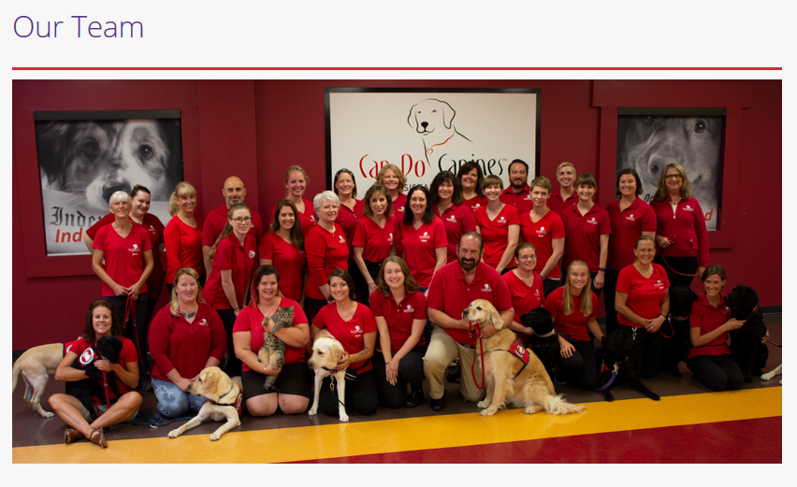
Bentley was really trained by a team . . .

Slide 37
Bentley was really trained by a team . . .
Bentley was an “owner provided” dog . . .
Here in Duluth I worked with Bentley every day . . .
Field trainer Kelly of Duluth worked with both of us once a week . . .
And Client Services Coordinator Elizabeth from the New Hope office worked with us in Duluth once a month . . .

Slide 38
Bentley was really trained by a team . . .
And the team supporting Bentley and me continue to be there after “graduation”
and continue to monitor our success and provide us with on-going lifetime support whenever we might need it . . .

Slide 39
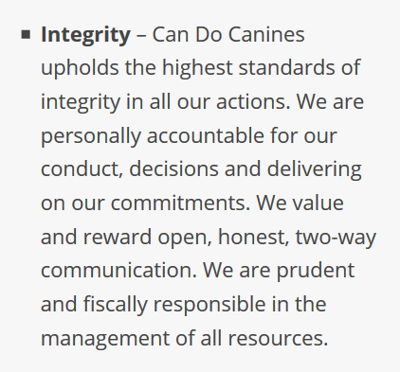

Slide 40
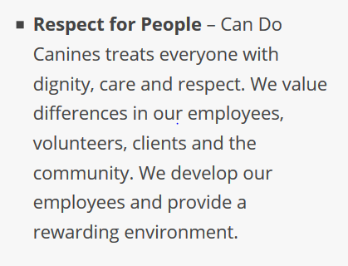

Slide 41
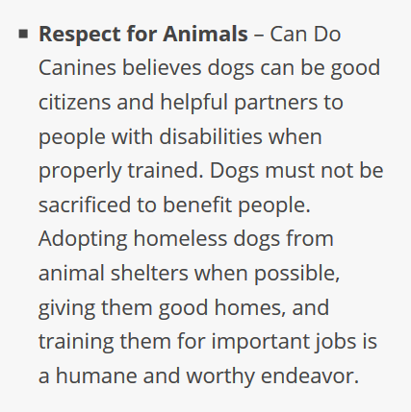

Slide 42
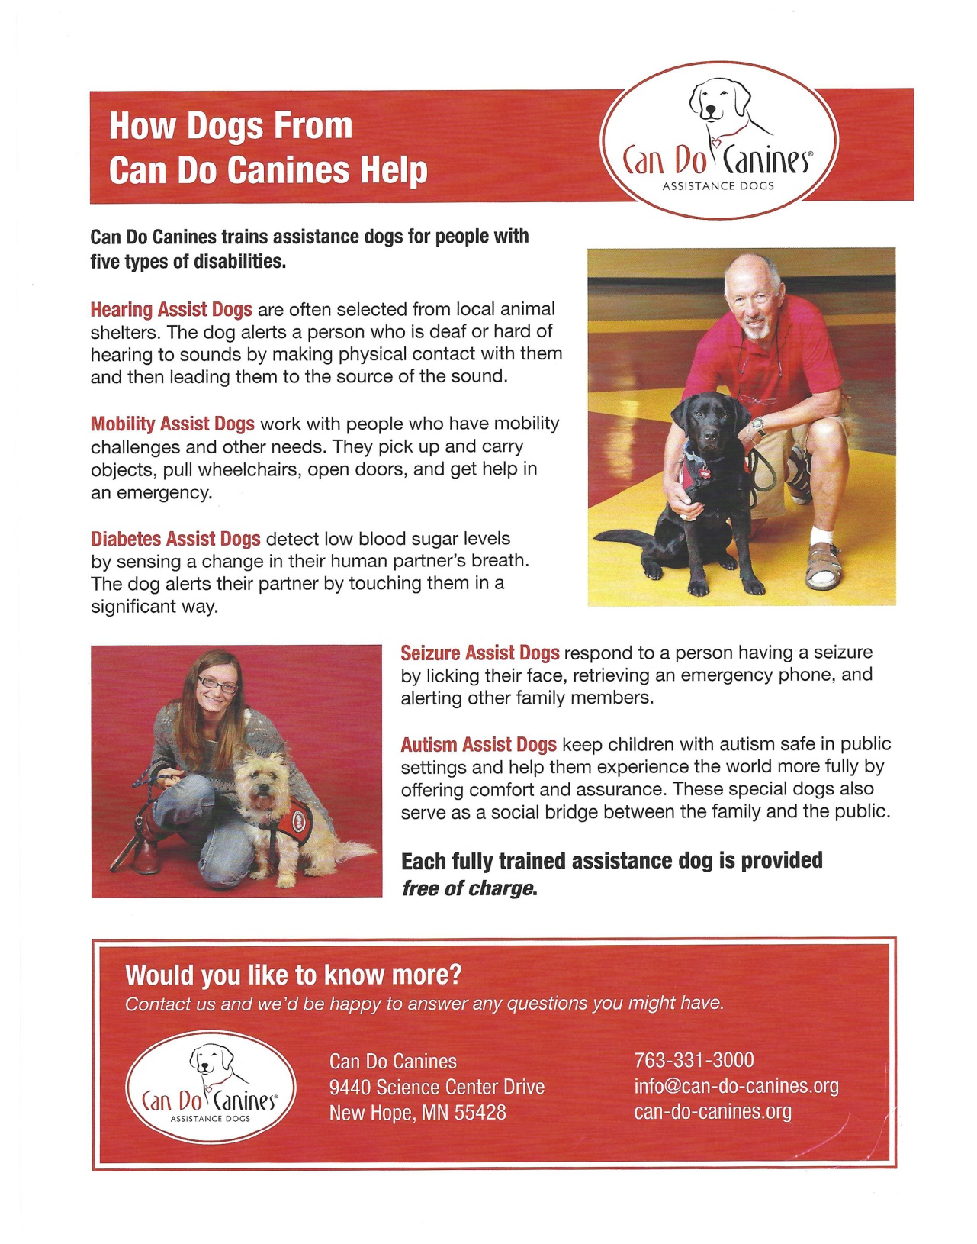

Slide 45
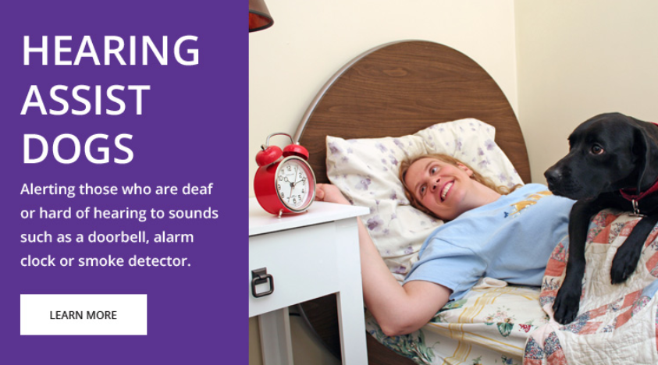

Slide 46
Bentley is trained to alert for . . .
smoke alarms
alarm clocks
door bell
knock on door
oven timer
phone timer
and to “go get” members of the family . . .

Slide 47
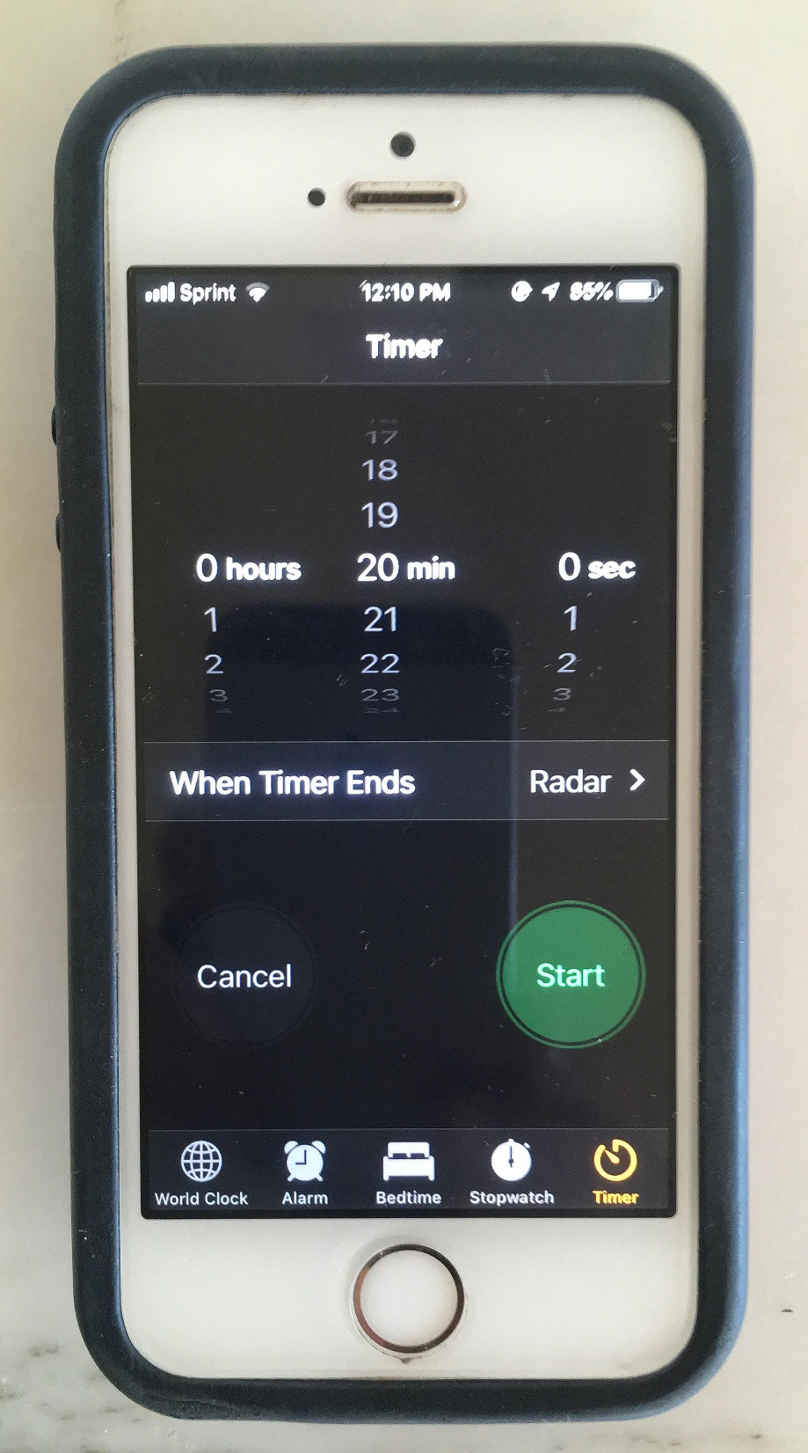
Hit the “Start” button on the phone and let’s see what Bentley can do . . .

Slide 48
Bentley is also trained to pick up his toys
and put them in his toy basket . . . but those are not part of his official job description . . .

Slide 49
Bentley is trained as part of his official job description to automatically go under the table when we sit down in a restaurant, and to stay there until one of the wait staff brings the bill . . .

Slide 50
On time in a restaurant the alarm of a man’s iPhone went off at the next table
(the same alarm we use) and he popped up from under the table and alerted me to the sound of the other man’s phone . . .

Slide 51
Part of his training is to alert even when that means he has to ignore a previous command, like “sit,” or “stay,” or to stay under the table. . .

Slide 53
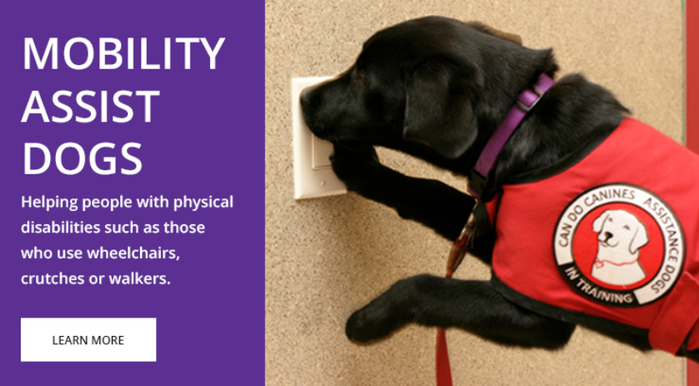

Slide 54
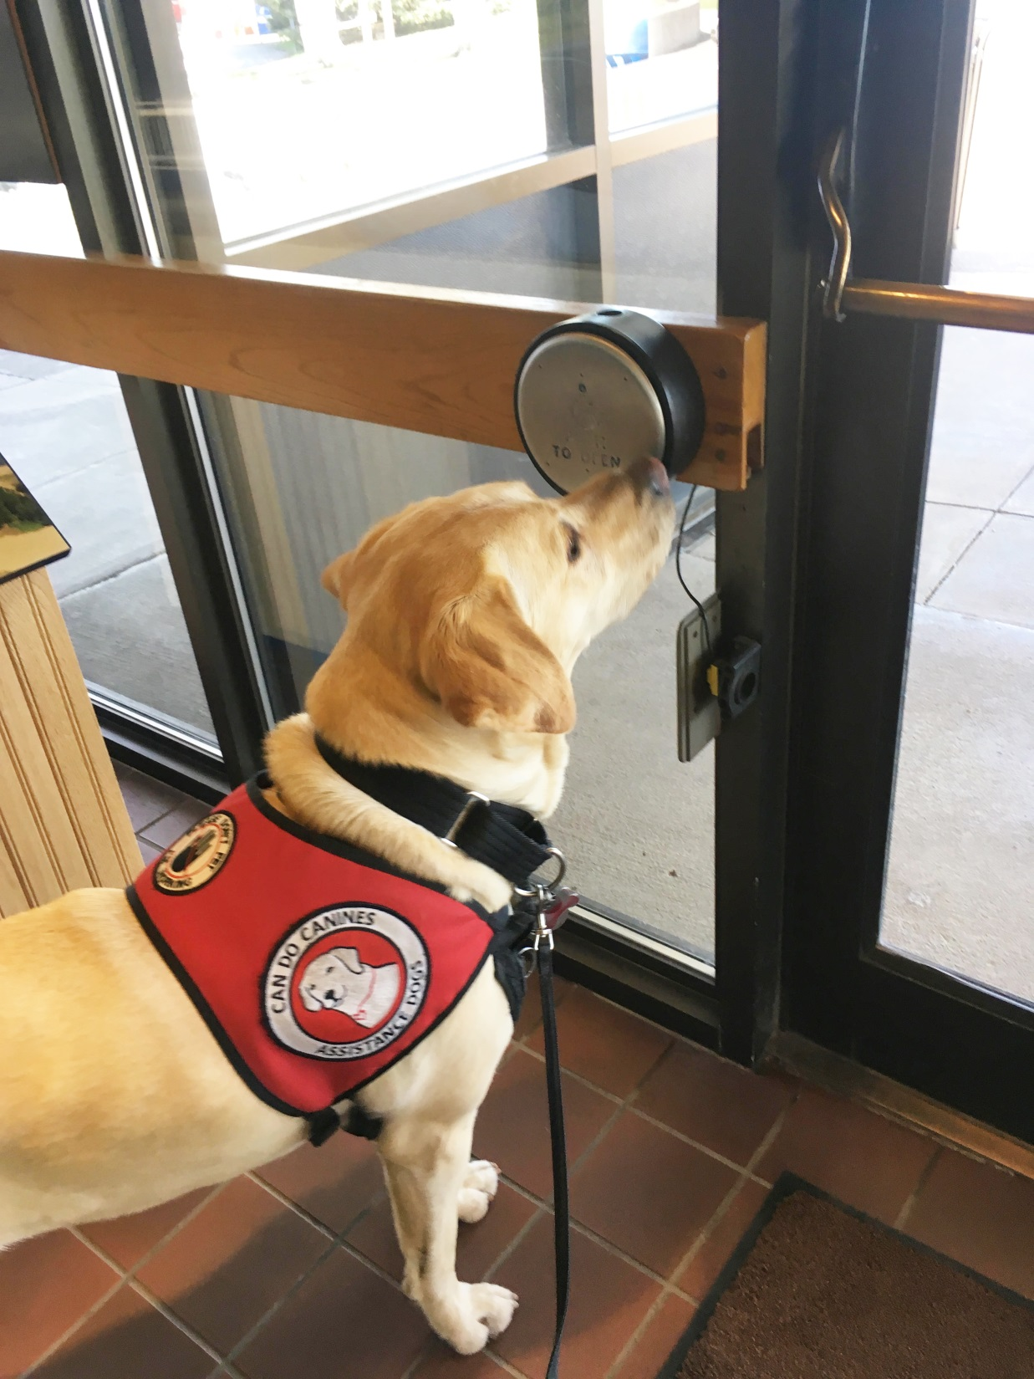
While Bentley is certified as a hearing assist dog
he loves doing other things that his certified mobility assist friends do . . .
Door opener

Slide 55
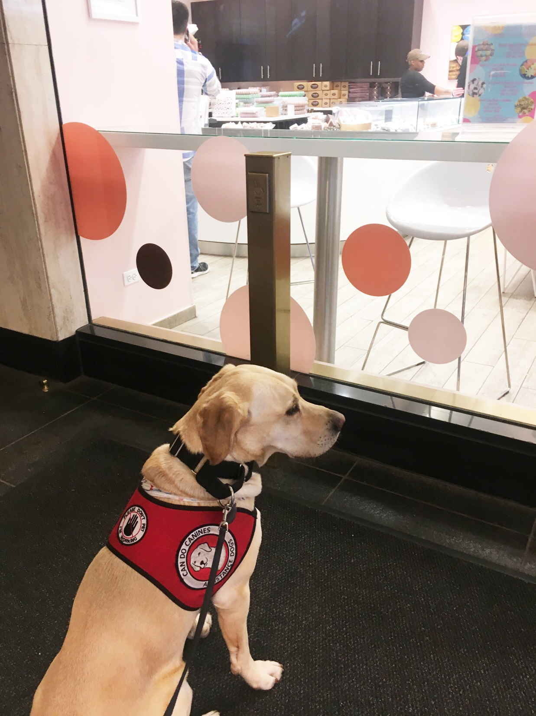
And Bentley is a genius natural problem solver . . .
The door opening button at the Palmer House in Chicago is right above his head . . .
Door opener

Slide 56
And Bentley is a genius natural problem solver . . .
Bentley has never seen a rectangular door-opening button like this before
. . .
Door opener
What the heck is this?

Slide 57
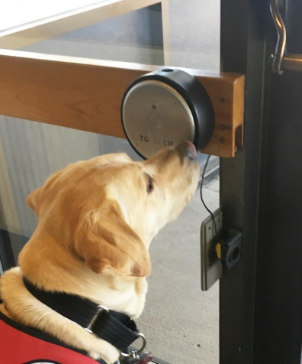
Door opener
Bentley’s unprompted first choice to open the door was . . .
the circle decal on the window
. . .

Slide 61
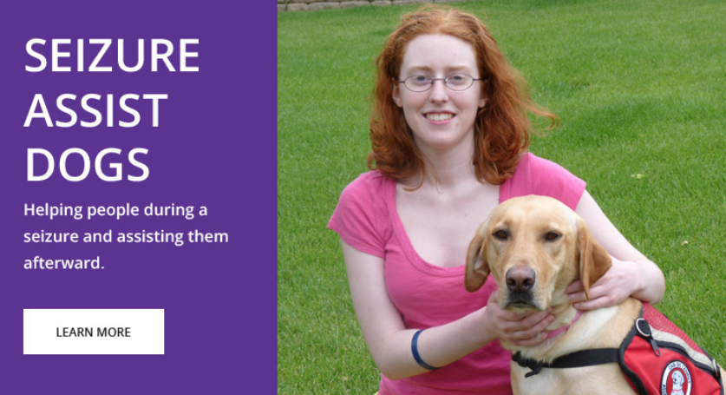

Slide 63
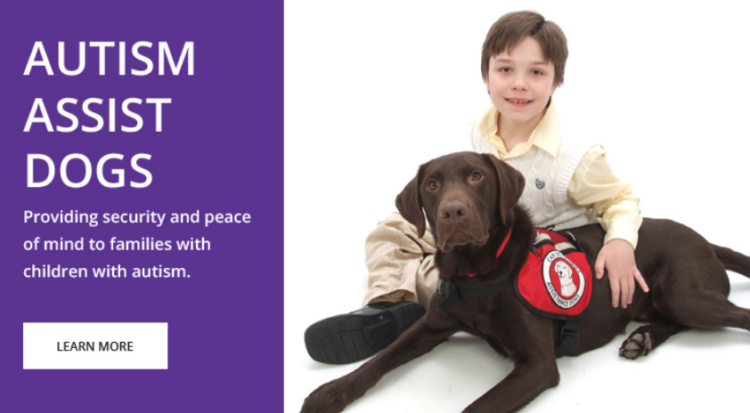

Slide 64
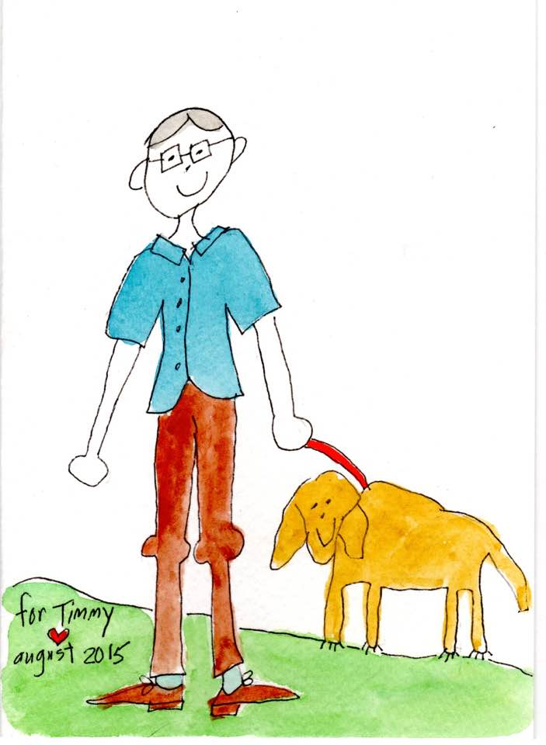
Timmy and Bentley Gretchen Roufs, 2015

Slide 65
Bentley has already once alerted me to alarms going off in a hotel and promptly insisted that I leave the building.
(It was -20 F outside, but he was not happy that I wanted to stay just inside the outer door, but he insisted I leave the building entirely. )

Slide 66
Bentley has once alerted me to alarms going off in a hotel and promptly insisted that I leave the building.
And as assist dogs are trained to focus on one person he left my wife, Kim, behind, and focused only on getting me out of the building

Slide 67
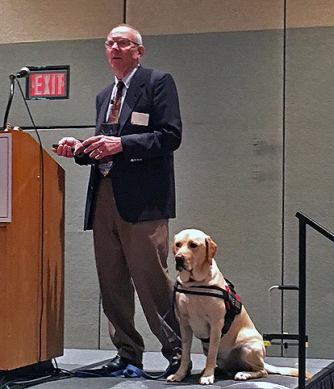
Bentley goes with me everywhere . . .
Tim Roufs and Bentley Fox Roufs
Allen D. Leman Swine Conference
CEFANS
College to career Seminar for High School Students

Slide 68
It’s
“Love me, love my dog . . .”
Tim Roufs and Bentley Fox Roufs
Allen D. Leman Swine Conference
CEFANS
College to career Seminar for High School Students

Slide 69
And people love Bentley . . .
He comes to every class with me at UMD,
and has since he was 7 weeks old . . .
And each semester in the course evaluations at the end of the year Bentley is rated one of the three best aspects of the course . . .

Slide 70
Bentley loves to travel . . .
He’s been on the “Flight to Nowhere” at the MSP Airport . . .

Slide 71
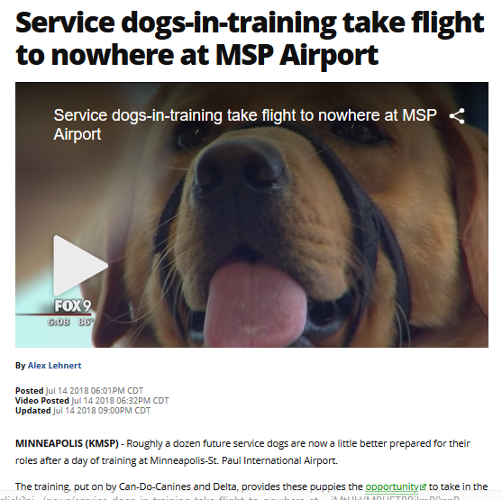
Bentley loves to travel . . .
He’s been on the “Flight to Nowhere” at the MSP Airport . . .
http://www.fox9.com/news/service-dogs-in-training-take-flight-to-nowhere-at-msp-airport

Slide 72
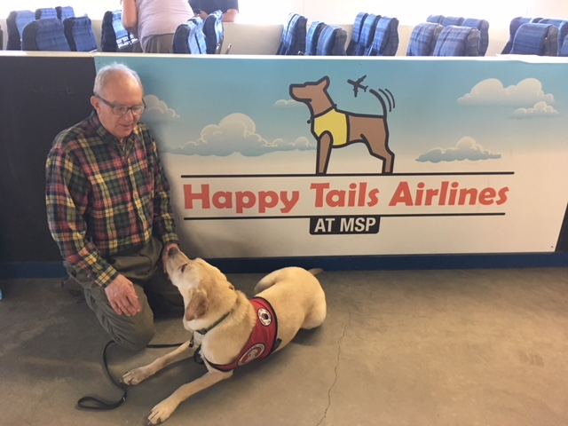

Slide 73
And since he takes his job very seriously he sometimes also does things on his own . . .

Slide 74
Like occasionally refusing to let me continue on our regular nightly walk in the dark by the vacant lot next door.
The first time he refused to let me go on, I didn’t know why . . .
until the next day when our neighbor posted her surveillance video online . . .
And since he takes his job very seriously he sometimes also does things on his own . . .

Slide 75
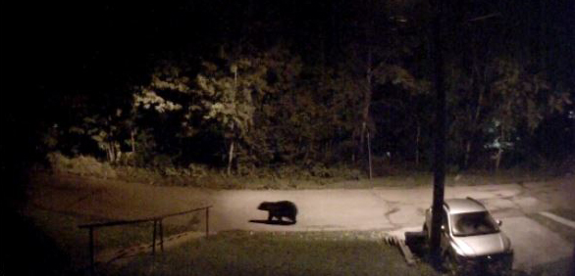
And it appears Bentley is not fond of bears in the neighborhood . . .

Slide 76
Bentley’s trainer, Kelly, has taught me to “TRUST BENTLEY” . . . and I do
and it almost is always the case that Bentley is doing the right thing . . .

Slide 77
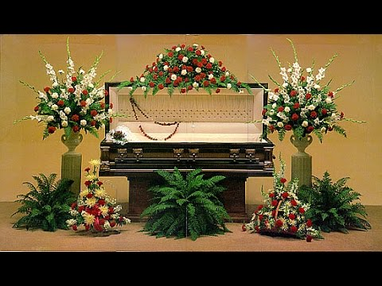
But Bentley does not like me to get close to dead people . . .

Slide 78
On a brighter note . . .

Slide 79
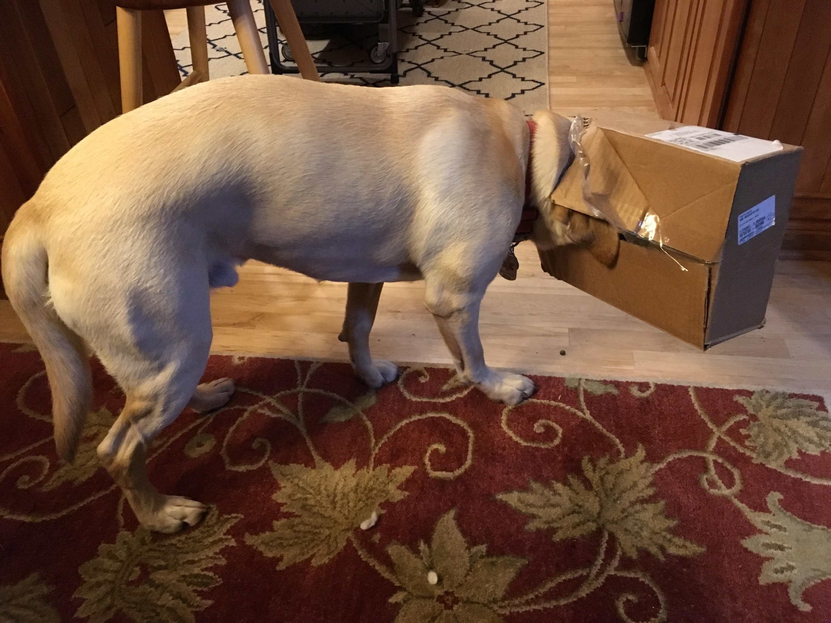
Bentley loves to do things like help open packages when he is off duty . . .

Slide 80
. . . a great organization.
Let’s have a look . . .

Slide 81
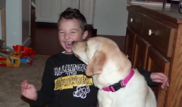
“How We Help”
Link (9:11)

Slide 82
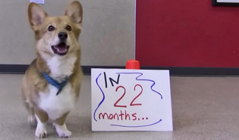
“In 22 Months”
link (2:17)

Slide 83
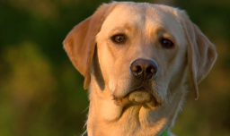
“25 Years of Service”
Link (3:42)

Slide 84
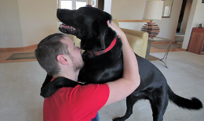
“Chad’s Journey”
Link (6:59)

Slide 85
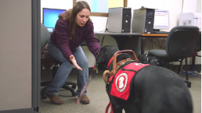
“Dear Can Do Canines – Amy & Dinger”
Link (2:58)

Slide 86
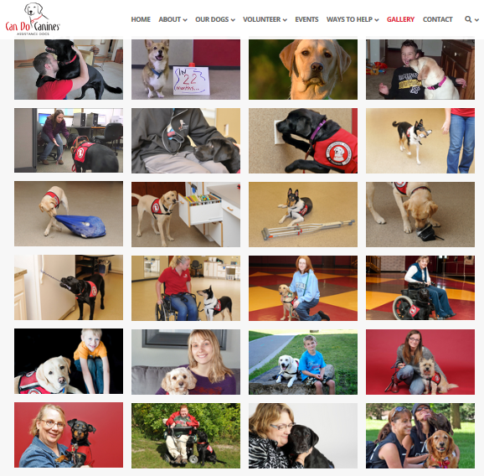
https://can-do-canines.org/gallery/

Slide 87
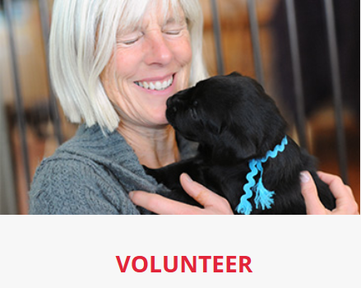

Slide 90
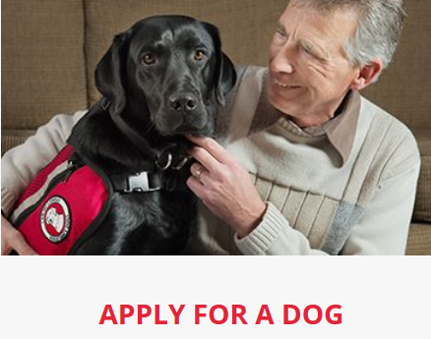

Slide 91
Thanks
https://can-do-canines.org/

Slide 92
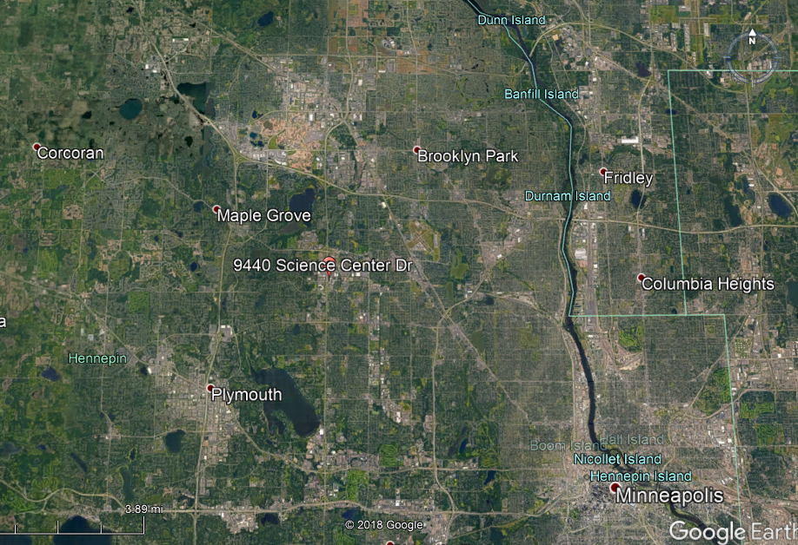
https://can-do-canines.org/

